Slide 1
Middleware Automation Internship Project : Jenkins driven MOSFS AT Tool Dev/Unit Testing
Animish Payal - Intern
Technical Mentor : Daniel Mortimer

Slide 2
Animish Payal
Education : Bachelor of Engineering in Computer Science
Institution : BITS PILANI, Goa Campus
Start of Internship : 28th May, 2025
Duration : 8 weeks
Team : Middleware Team, India

Slide 3
Overview
Introduction
Dev Testing: Previous State
Key Improvements & Solutions Implemented
Challenges Faced
Future Recommendations
My Learnings

Slide 4
MW AT Tools Testing Automation | Overview
Goal | Automation of Development Testing: Creation of a test plan repository for storing of test plan inputs and artifacts. Automation of the testing workflow leveraging records in the test plan repository.
Benefits | Faster and user-friendly test setup and execution Reducing manual intervention , minimizing errors Sharing of test setups (plans) Consistent , repeatable results across development cycles.
Technical Learnings | DevOps Fundamentals Containerization Shell Scripting Python Json File handling
Soft Skills | Problem-solving, attention to detail. Understanding the importance of the end user perspective. Communication, adaptability and collaboration.

Slide 5
Dev Testing: Previous State

Slide 6
Previous Dev Testing Scenario| Key Characteristics
Manual Setup
Developers individually set up their environments and cloned repositories.
Test plans and input files created and managed manually.
Limited Automation
Running tests required manual intervention at multiple steps, increasing the risk of errors.
Most of the staging setup and running manually handled from Command Line.
Error-Prone
Manual processes might lead to frequent errors, such as incorrect input data.
Developers might have to manually verify proper test directory structures.
Time Consuming
Routine tasks (like staging files, generating input files or running tests) might become time consuming.
Dependency on MOSFS UAT system for creation of DX input files might create bottlenecks due to MOSFS availability issues.
6
Copyright © 2025, Oracle and/or its affiliates | Restricted
Notes:
I’ll talk about the key challenges we faced with our previous Dev Testing approach. Everything began with manual setup—users had to clone repositories and create test plans individually. Because so much was handled manually, this made it error prone, from having incorrect input data in input files to organizing test directories. With limited automation, activities like running tests and staging files relied on repeated command-line steps, making the process slow and increasing the risk of mistakes. This could result in a lot of time spent on routine tasks, especially when facing bottlenecks from system dependencies or unavailable services. For example as mentioned in the slide for Dx input creation there was a dependency on MOSFS UAT system which if unavailable may create a bottleneck.

Slide 7
Key Improvements and solutions implemented

Slide 8



Development Testing| Semi Automated Workflow
Test Plan Repository
Test Plan Execution
DXF Container
User creates and stores a test plan record in which includes:
Test Plan name and description
Dynamically generated DX input file
For “File Ready” test plans - pre-staged test file
Execution of a test plan record via command line or Jenkins
Execution takes inputs from test plan record
Test execution launches a copy of the DXF container using podman.
Test plan record artifacts are copied into the container.
Tests are executed inside the container.
Test output and logs extracted from the container for review.

Slide 9
Test Plan Repository | Automated Test Plan Workflow
Test Plan Manager
Create Test Plan
View Test Plans
Delete Test Plan
Stage and Run Test Plan
Test Plan Repository
Pre-Staged dx input Json Files
Pre-Staged Test Files
Pre-Staging is storage location specific(Can be local to user)
Test Plan Record Entries

Slide 10
Test Plan Manager | Key Features
User Input:
User interacts with a menu-driven interface to start the process.
Dynamic Input File Generation:
Script prompts for required details ( e.g Product Version, SR Description etc) by parsing through a sample Json Template and looks for tokens made to identify placeholder required for the test.
Organised Test File Staging:
Test files are placed in dedicated Pre-staging folders, improving organization and traceability.
Central Log/History:
Each test run is logged with its SR number, SR title , User etc , supporting easy tracking and reduces manual intervention for organisation.
Automated Test Execution:
Tests can be executed locally or triggered via Jenkins.
Input Validation:
Ensure data follows proper Regex rules and helps prevent error before proceeding.

Slide 11
Input File Generation| Key Features
Template Parsing with Placeholders
The script reads a JSON template containing placeholders for inputs pertaining to Event Types:
New SR
File Ready
Interactive
Requests for input categorized for basic and advanced users.
User Type Detection
For basic users, only essential fields are prompted, keeping the process simple and quick.
Advanced users can access and customize additional, less common parameters.
The placeholder tokens are flexible can be modified according to user’s requirements.
Example of Tokens :- %bas (basic string attribute), %adx (advanced string attribute) and %adxjson (advanced JSON attribute).
Default Values for Efficiency
Each field comes with a sensible default value.
Users can accept defaults or override them as needed, reducing repetitive data entry.
Streamlined & Error-Resistant
The script ensures all required fields are filled, either by user input or defaults.
This approach minimizes errors and saves time, especially for frequent tasks.

Slide 12
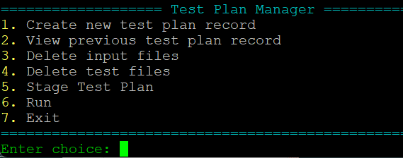
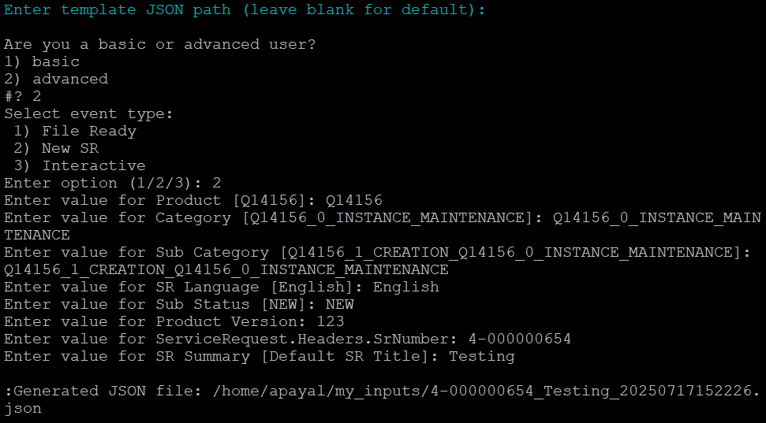
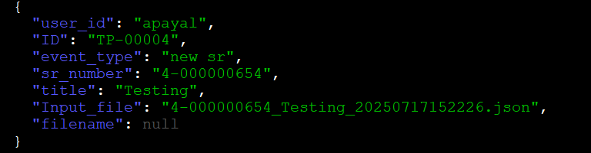
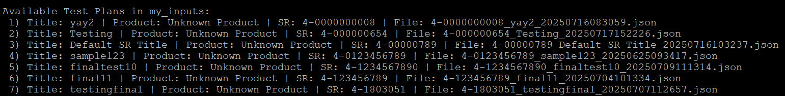
Test Plan Manager | Workflow
Creation of Test Plan
Menu Driven Test Plan Manager
Runs the DXF Container for Test Run of Staged files
Sample Entry of Test Plan Record
Staging of Test Plan
Test Plan ID
(acts as identifier for Test plan)

Slide 13
Orchestration| Jenkins
How Jenkins Uses Parameters
Jenkins jobs are set up to accept user-supplied test plan record reference.
Jenkins pipelines (Groovy Scripts) reads the test plan record these parameters at runtime and dynamically adjust the workflow.
Automated Handling of Test Plan Artifacts
Jenkins fetches the required input files from the local CEL host using the user provided parameters.
Results and logs are saved back to the CEL host for easy access.
The user can also access the test results directly from the Jenkins UI with help of artifacts feature.
Central File Storage
The CEL host serves as a shared server for input file , test plans and output logs.
Staging of codebase and Test Plan to be tested
Jenkins helps replicate the entire Testing structure along with Test Plan artifacts inside the Podman DXF container
Access & Security
Jenkins is configured with necessary credentials to securely read/write on the CEL host local to the user.
Key Benefits
Consistent, traceable and repeatable test runs
Centralized management of files and results via the CEL Host.
User-friendly : Test at the press of a button

Slide 14
Orchestration| Jenkins workflow
Test Plan Repository
Input files
DXF container
All events types
(New SR, File Ready, Interactive)
Test Plan Execution
(Test Plan artifacts are copied inside)
ALM Jenkins Agent
Test Plan Record
READ
Test Results
(Archived artifacts)
Test Files
If Event Type is “File Ready”

Slide 15
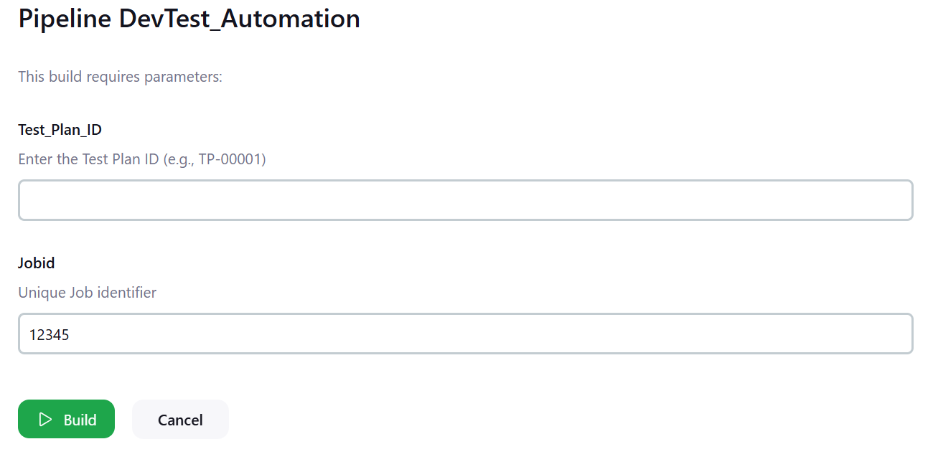
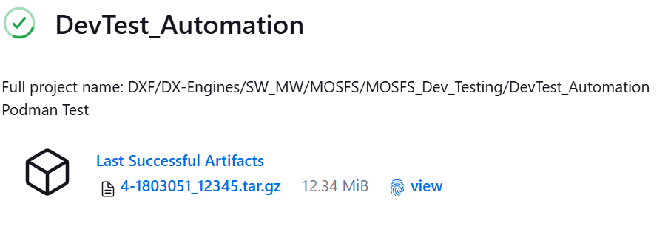

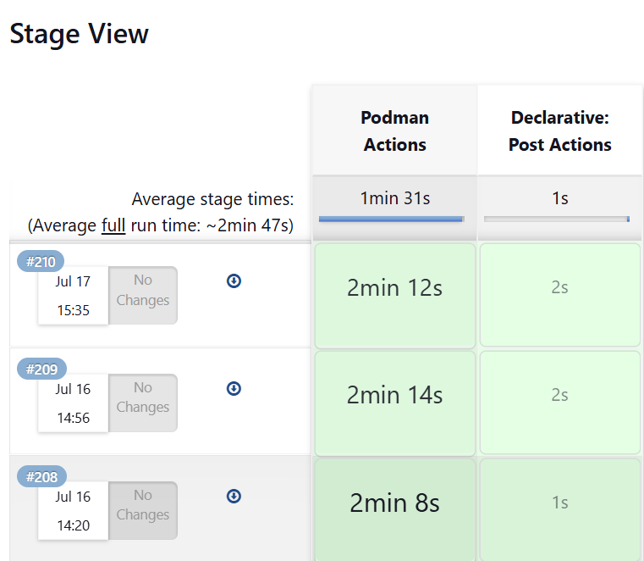
Jenkins Automation| Overview
Unique Identifier for Test Plan to execute
Test Output for the Test Plan
Uniquely identifiable by Job Id
Pipeline Stages
Jenkins allows user to access test results of previous 6 Test executions
Runtime of each
Pipeline stage

Slide 16
Biggest Challenges | Technical
Challenge:-
Shell Scripting is not inherently designed for complex data structures like JSON.
Impact:-
This added complexity when automating input file generation involving JSON templates.
Resolution:-
Parsing nested fields, handling arrays and updating values required creative use of tools such as ‘jq’ and careful error handling. ( jq helps in JSON manipulation)
Challenge:-
Not all fields in the input JSON template are equally important for Dev Testing. Distinguishing which parameters hold importance was a challenging task.
Impact:-
Incorrect prioritization could lead to incomplete test coverage and might lead to incorrect results.
Resolution:-
I had to run tests with different configuration of input files to find out relevance of each field and further developed a clear mapping of essential versus optional fields.

Slide 17
Biggest Challenges | Technical
Challenge:-
Attempting to run Podman containers inside a Kubernetes(k8s) cluster on Jenkins introduced compatibility and networking issues. Restrictions on container deployment complicated the setup.
Impact:-
This led to problems with deployment of Podman DXF containers in Jenkins and affected test runs.
Resolution:-
We shifted the build agent to point towards the local CEL host. This provided us with more controlled and familiar environment for Podman-based testing and reduced operational friction.
Challenge:-
Designing scripts that effectively serve both developers(seeking deep control) and
end users (needing simplicity).
Impact:-
Required reconciling different priorities for flexibility and ease of use, which at time could complicate the overall script design.
Resolution:-
Iteratively testing and refining workflow and looking at each part with both views. This resulted in balanced and adaptable script meeting needs of both kind of users.

Slide 18
Future Recommendations

Slide 19
Future Recommendations
Unified Front End for Test Plan Repository & Jenkins
Develop a single web interface for input file management, Jenkins job triggering, and results tracking.
Streamlines user experience and centralizes authentication and permissions.
Jenkins Improvements
Dynamic Input File Creation
Storing all placeholders while creation of Test Plan so that at runtime Jenkins dynamically generates input files
on the fly using the stored data.
Non-Interactive Input Creation Using Properties Files
Supply input parameters as ‘.properties’ or environment files for Jenkins.
Enables fully automated(non-interactive) tests runs on Jenkins.
Supporting Multiple Test Plan Runs in Jenkins
Enable the Jenkins job interface to accept a list of test plan IDs.
The pipeline can iterate over each provided test plan ID and executes the automation workflow for each Test Plan.
Template Versioning
Maintain versions of input template being used for easy traceability and helps in efficient reuse of templates.

Slide 20
My Learnings

Slide 21
Technical Learnings
DevOps Fundamentals
Build a basic foundation in DevOps principles, emphasizing automation and agile methodologies
I gained hands-on experience with Jenkins pipelines using Groovy Scripting.
Containerization
Learned the concept of containerization of testing environments using Podman.
Learned about creating , deploying and managing Podman containers across local and Jenkins-based pipelines.
Shell Scripting
Advanced shell scripting proficiency to automate environment setup, file handling, and test orchestration.
Built modular, menu-driven for repetitive Dev Testing tasks using Shell Script tools.
Python
Learned use of python for parsing, manipulating and validating complex input and test plan files.
Explored Python’s strengths for data processing and few aspects not easily handled by shell scripts.
JSON File Handling
Gained skills in parsing , generating and validating JSON files within Shell Scripts.
Implemented logic to manage test plan templates, support dynamic user input and implement regex in Input JSON file creation.

Slide 22
Oracle Competencies | Proficiency Gained
Competency | How I improved
Change Ability | Embraced new tools and workflows (Jenkins and Podman). Adapted automation solutions in response to feedback and requirements.
Collaboration | Worked successfully with various team members, sought help and guidance for various challenges and project requirements.
Communicating for Impact | Documented technical processes on Confluence as User Stories, presented updates on work with concise summaries, highlighted opportunities for further enhancements, etc.
Mastering Complexity | Studied and understood Bash/JSON parsing , infrastructure dependencies and dove deep into the current setup to understand what needs to be changed.

Slide 23
Thank You

